Slide 1
Single versus Double Blind Reviewing at WSDM 2017
By Qingkun Liu

Slide 2
Introduction
Single blind review
Double blind review

Slide 3
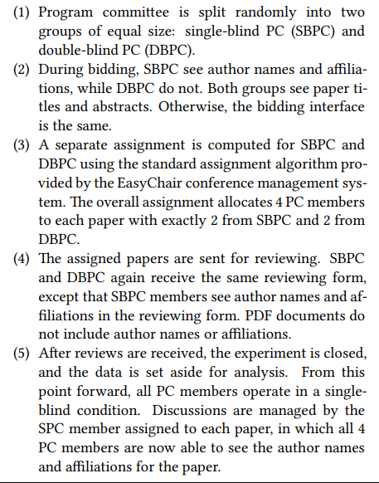
Experiment

Slide 4
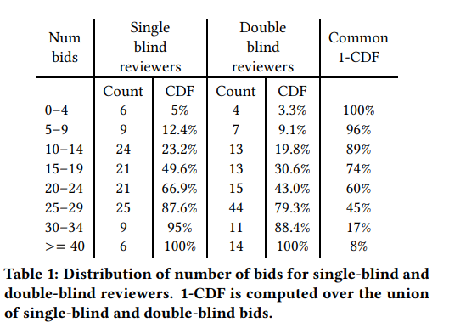
Result

Slide 5
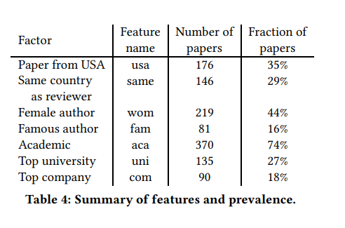
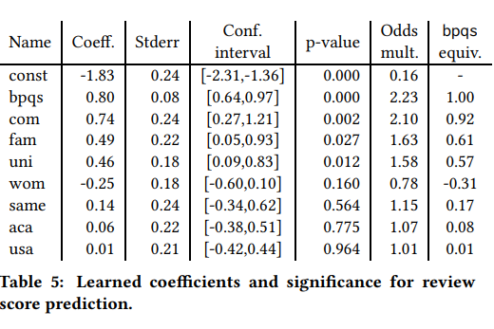
Result

Slide 6
Thank you

